Slide 1


Housing Data Julius Andrey Mayo Rebekah Shaw Joseph Martinez Mindy Musch
Zillow Home Data Analysis
What is Zillow?
Scope and Limitations of our Research

Slide 2




Key takeaways:
Rental Prices:
Increased year over year
Zillow Home Values:
Home values increased year over year
Listing Numbers:
Texas has significantly more listing than other states
Median List Price:
List prices increased year over year

Slide 4
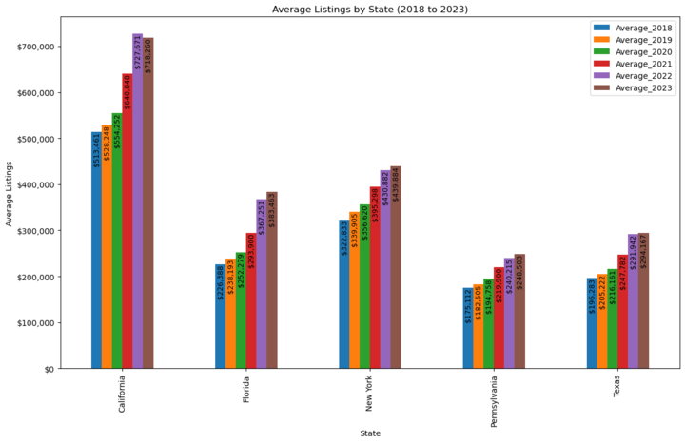

Slide 5
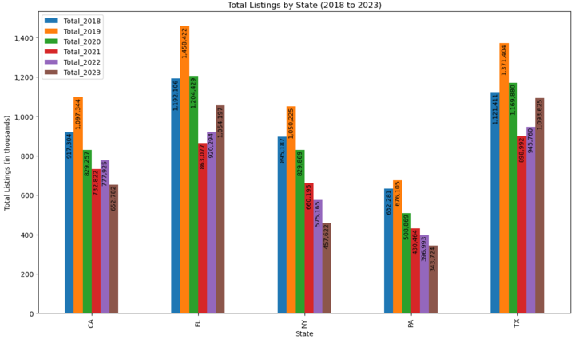

Slide 6
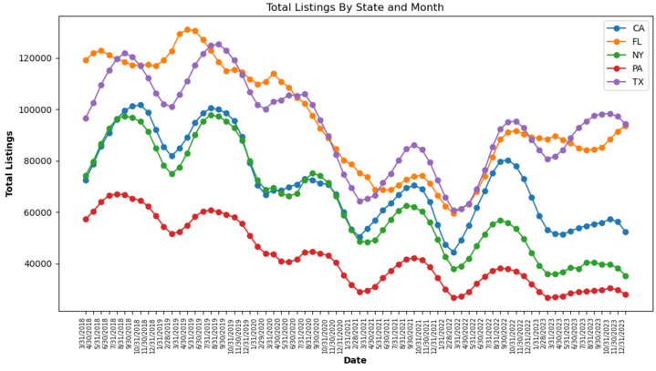

Slide 7
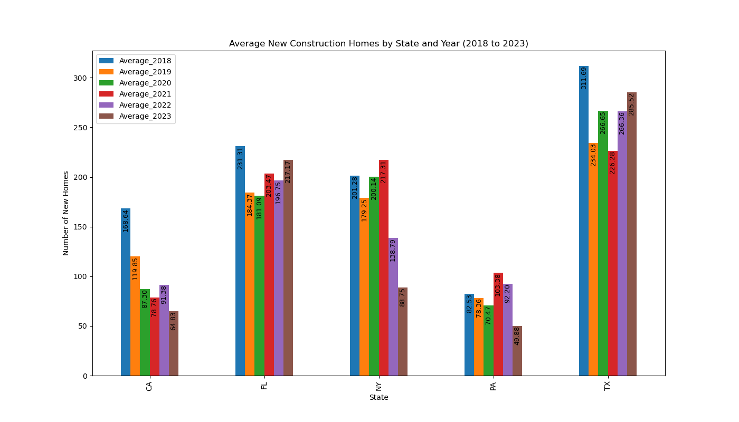

Slide 8
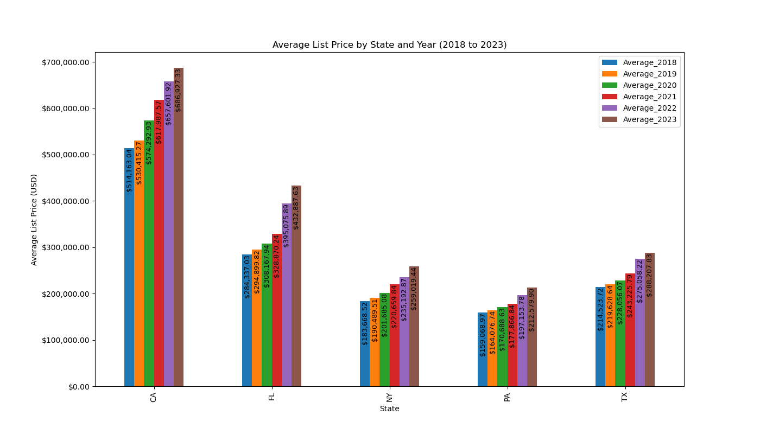

Slide 9




SUMMARY
Roof
2nd Floor
1st Floor

